Slide 2
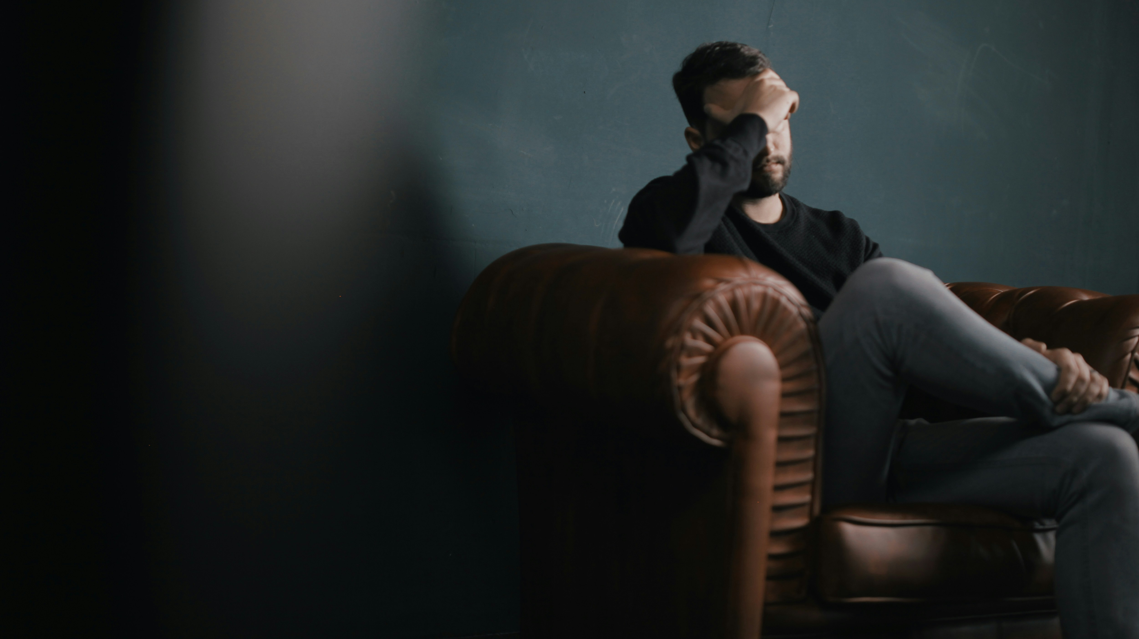
1 in 4
Canadians are living with a mental illness or substance use disorder.
Of those, only 1 in 3 people will seek access to care.
And of those, only 1 in 5 will have their needs fully met.

Slide 3
1 in 4 Canadians are experiencing a mental illness or substance use disorder issue right now.
25% of Canadians are living with depression, anxiety, or post-traumatic stress disorder.
12 people die by suicide each day in Canada.
Only 1 in 15 people living with mental illness or substance use disorder receive effective care.
By 2030, depression is expected to become the number one reason for health issues worldwide.
1.2M
Canadian youth are living with depression.
30%
of individuals living with depression are not seeing improvements from their treatment plan.
60%
of young people lose access to continued mental health care when they reach adult age.
21%
of Canadians are living with a substance use disorder.

Slide 4
17
Notes:
- # of years it takes to turn research into readily available care/treatment

Slide 5
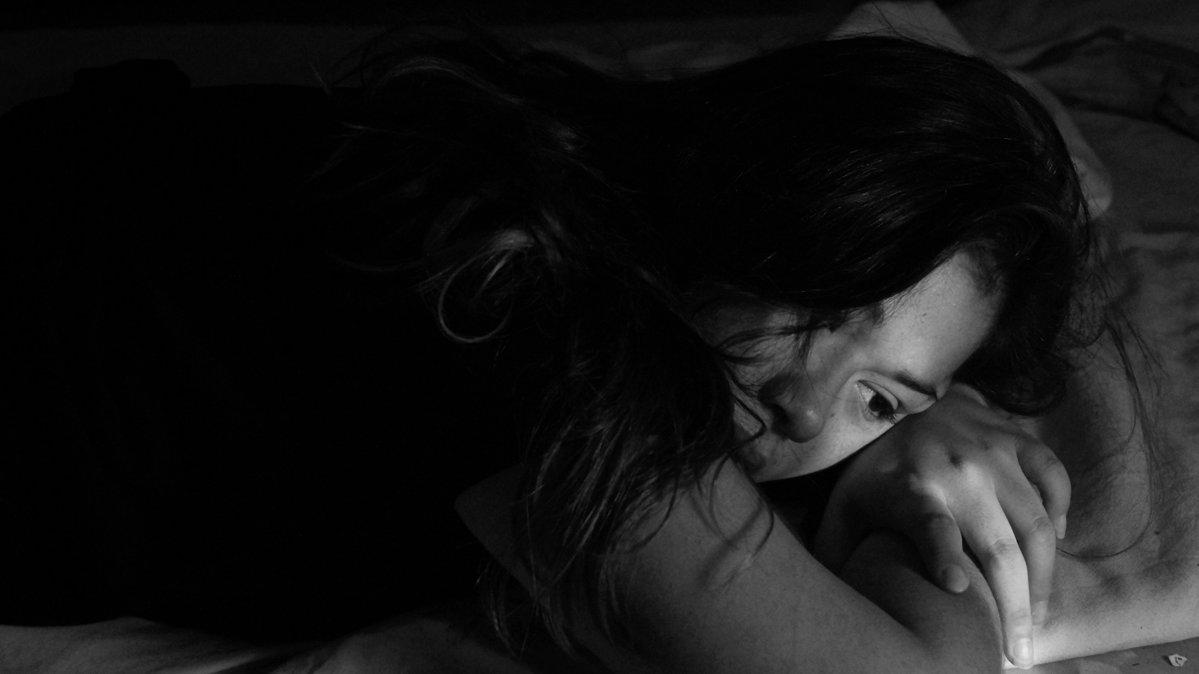
Worldwide, mental health research funding receives less than $0.50 USD per person annually.

Slide 6
15,000 patients
served yearly
100+ researchers
6,000 patients engaged in 150 research projects

Slide 7
ACCELERATING DISCOVERIES INTO CARE:
Neuromodulation
69%
response rate
54%
remission rate
3 min
treatment time
80
people treated

Slide 8
ACCELERATING DISCOVERIES INTO CARE:
Suicide prevention

Slide 9
CREATING A MODEL SYSTEM THAT INTEGRATES RESEARCH INTO CARE
CURRENT STATE
FUTURE STATE
Fragmented and siloed research and care communities.
Integrated system of research and care.
Scarcity of expert mental health scientists and trained clinicians able to administer new discoveries.
Thriving expert community with a robust talent pipeline.
Research-based tools seamlessly integrated into care and accessible to patients and clinicians.
Inaccessible breakthrough tools confined to research.
Robust and collaborative data infrastructure advancing research and personalized care.
Limited data capture and sharing.

Slide 10
CAMPAIGN CABINET
HONOURARY CHAIR
Rt. Hon. David Johnston
HONOURARY CHAIR
Sharon Johnston
CO-CHAIR
Yann Robard
CO-CHAIR
Melissa Kruyne
EXECUTIVE MEMBER Dr. Raj Bhatla
EXECUTIVE MEMBER
Vittorio Pellegrino
EXECUTIVE MEMBER
Larry Kelly
Executive member
Mark Taggart
Executive member
Johannes Ziebarth

Slide 11
The way my brain processes things has absolutely changed. I never would have imagined that I could be as well as I am today.
- Marion Beckett

